Slide 1

VDRS Website Enhancement

Slide 2
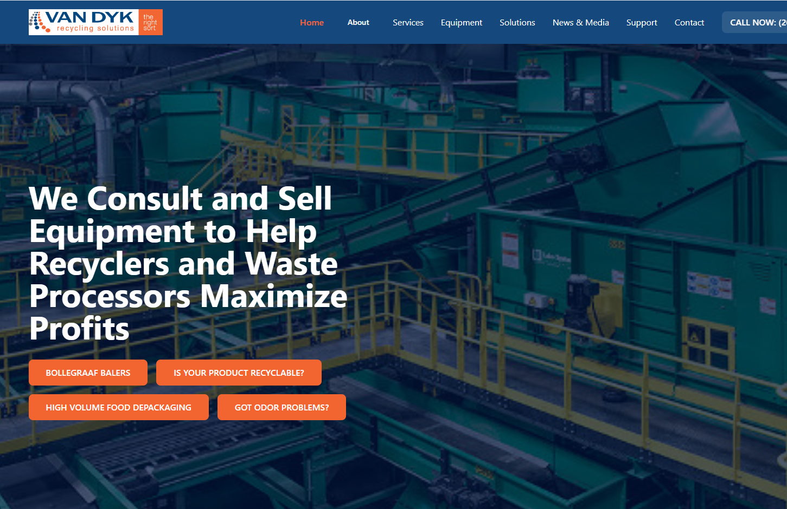
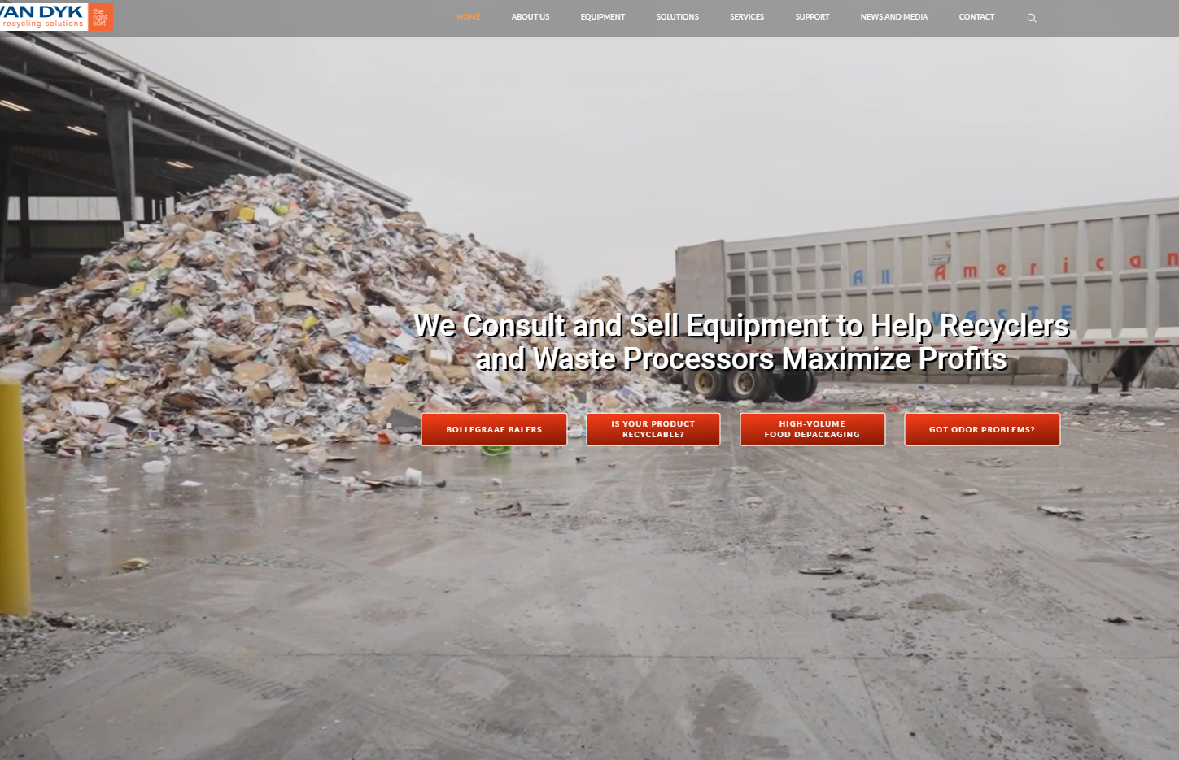
Summary
This brief summarizes the transformation of the VDRS digital presence by comparing the current website with a modern UI prototype hosted on Netlify. The goal is to revamp the VDRS website using modern design systems, intelligent chatbot assistance, and enhanced customer engagement tools, while ensuring accessibility and mobile-first performance.

Slide 3
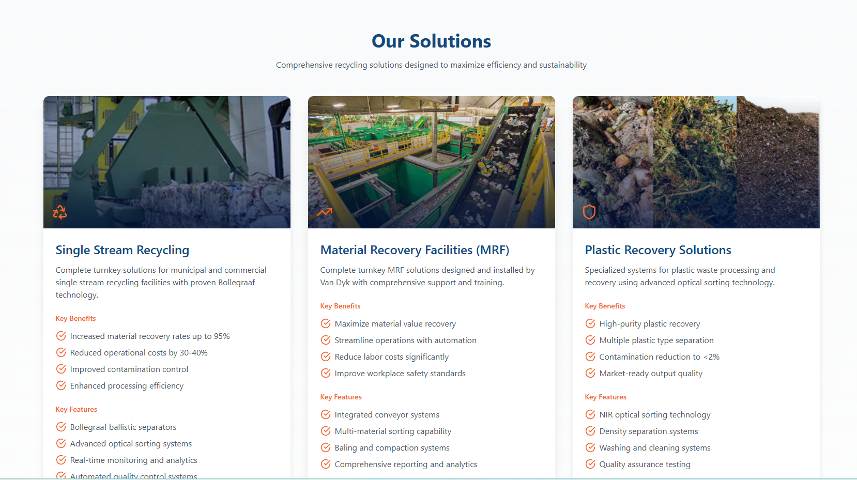
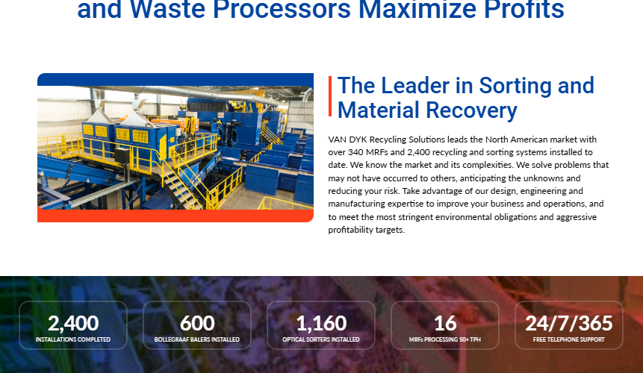
Key Changes
Core Feature Enhancements:
Interactive Equipment Showcase: Modal-based component views for equipment.
Services Page: Structured, comprehensive information sections.
Validated Contact Form: Built with React Hook Form and Zod.
Framer Motion Animations: Smooth page transitions and hover effects.
News & Media Center: Filtering and keyword search features.
Support Center: Multi-tab resource portal (FAQs, guides, downloads).
Integrated Chatbot: Smart assistant for navigating solutions and services.

Slide 4
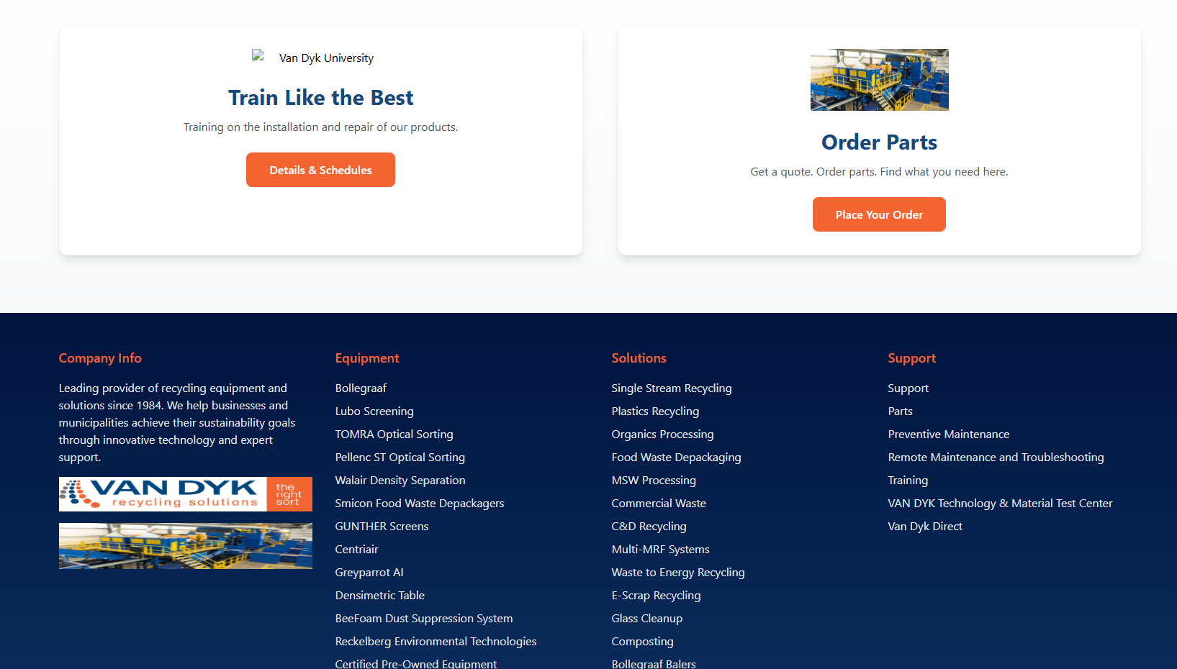
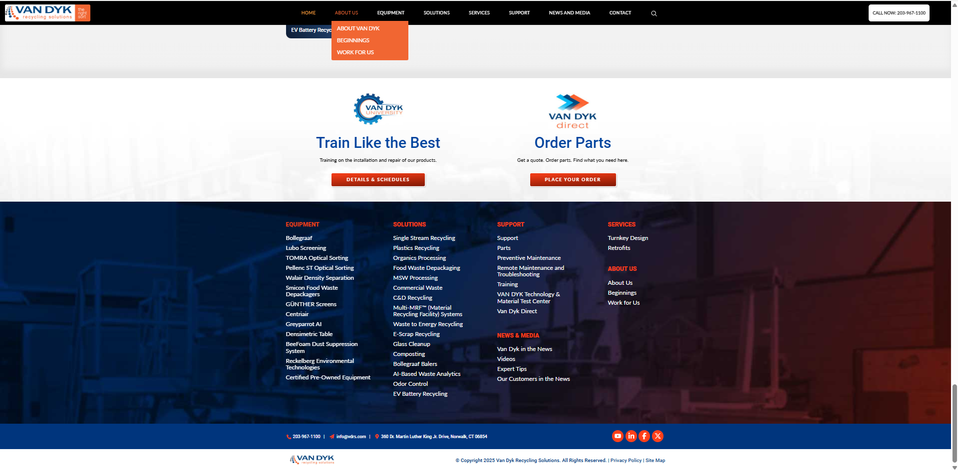
Key Changes
Modern Design Elements:
Minimalist Interface: With bold color strategy and hierarchy.
8px Grid System: Ensures consistent spacing and layout integrity.
Responsive Layouts: Fully optimized for mobile, tablet, and desktop.
Interactive UI Components: Hover transitions, scroll animations.
Clean Navigation: Scroll-aware sticky header and intuitive structure.

Slide 5
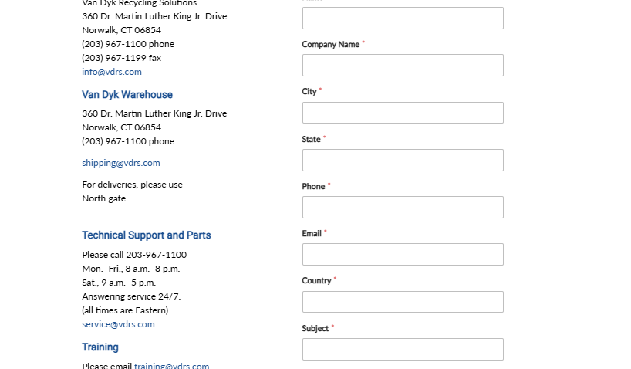
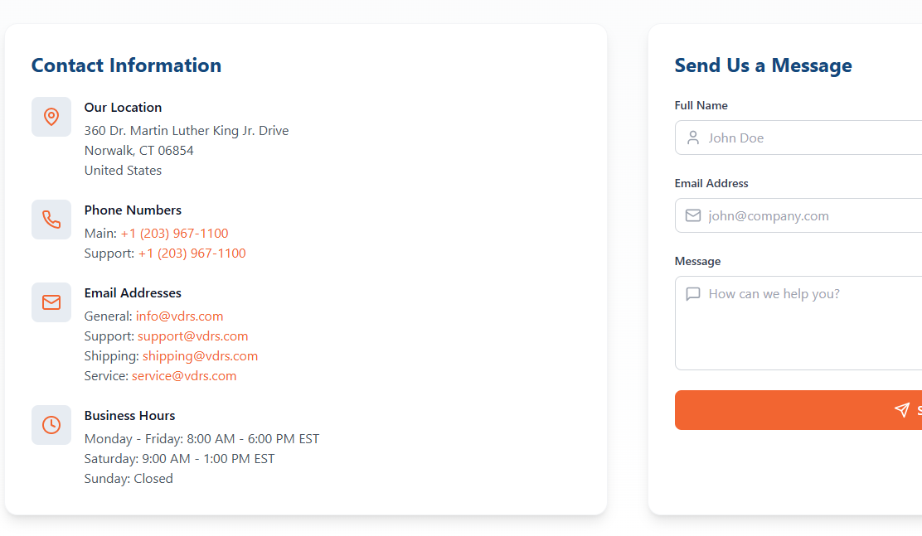
Core UI Design Principles
1. User-Centricity
Design for recycling professionals, tailored user journeys.
Prioritize quick access to products, services, and support.
Implement responsive and intuitive layouts.
2. Visual Hierarchy & Typography
Three-level text structure: headings, subheadings, body.
Professional fonts and scalable ratios.
High contrast, accessible font sizes.

Slide 6
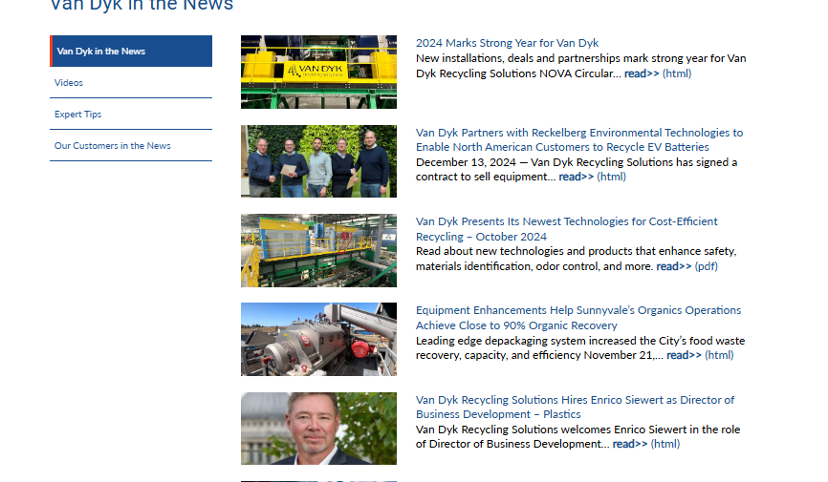
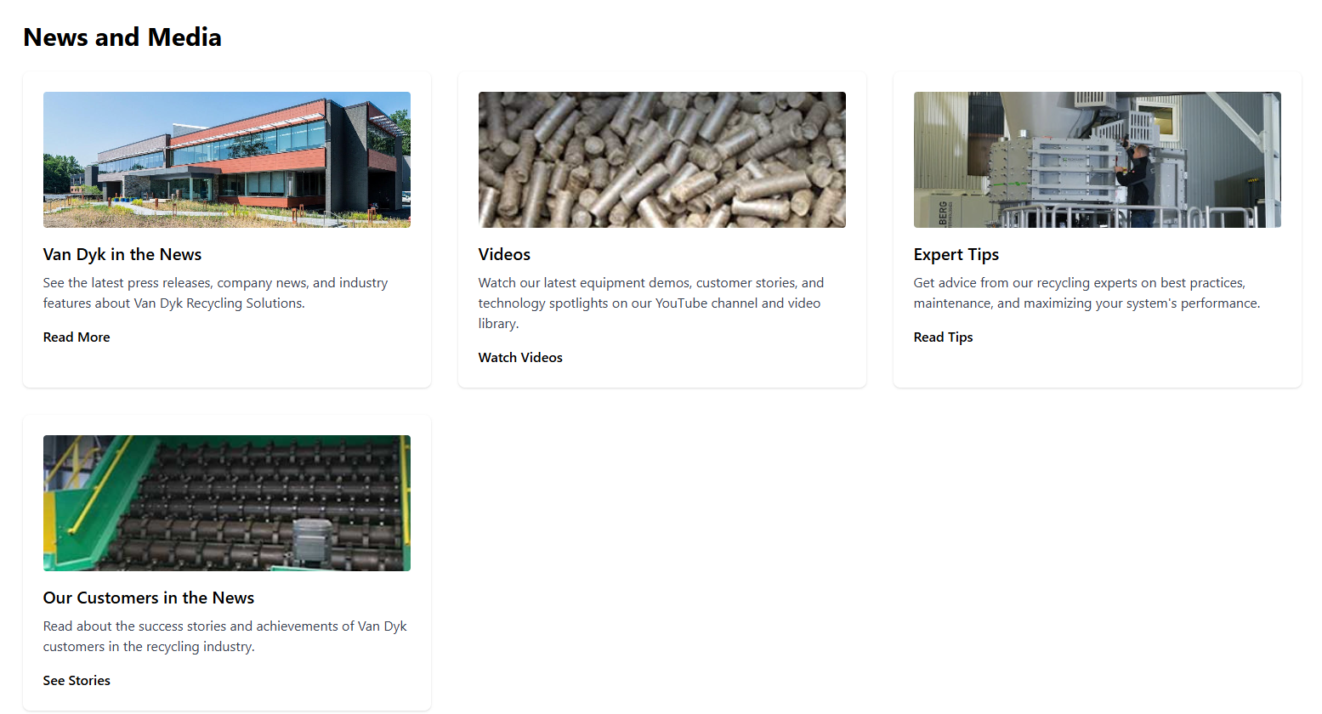
Core UI Design Principles
3. Brand-Aligned Color System
Environmental themes (greens, blues, neutrals).
High contrast and WCAG 2.1 compliance.
Use of color as a visual guide for sections.
4. Card-Based Layout
Technical and service content segments into digestible blocks.
Consistent, responsive blocks suitable for both mobile and desktop.

Slide 7
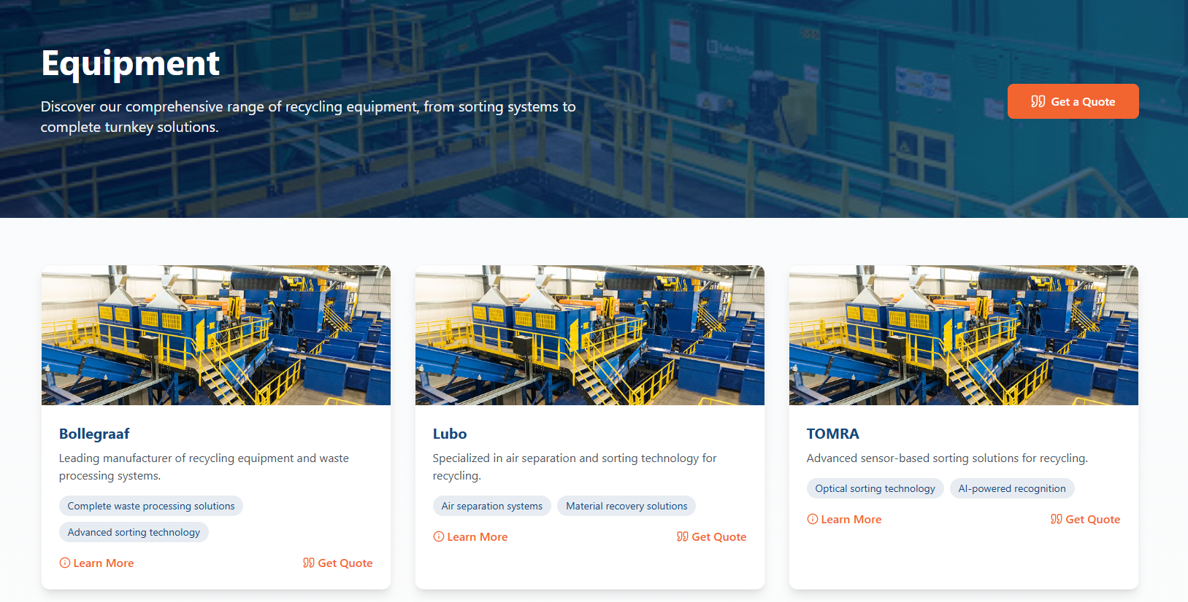
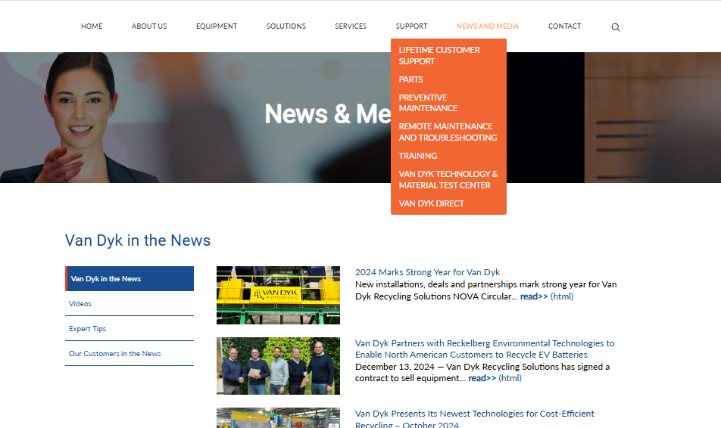
Core UI Design Principles
5. Transitions and Micro-Interactions
Subtle feedback on clicks, hovers, and navigation.
Enhances engagement without overwhelming the user.
6. Responsive Grid Systems
CSS Grid for modular layouts.
Adaptive across all screen sizes.
Consistent alignement, efficient content prioritization.

Slide 8
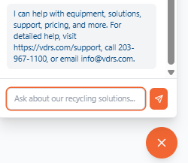
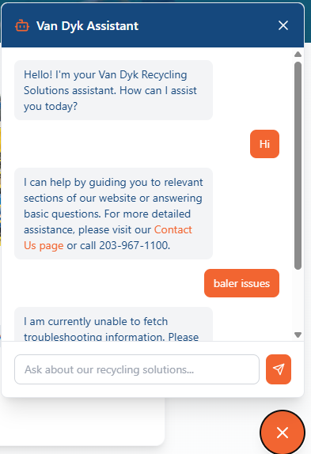
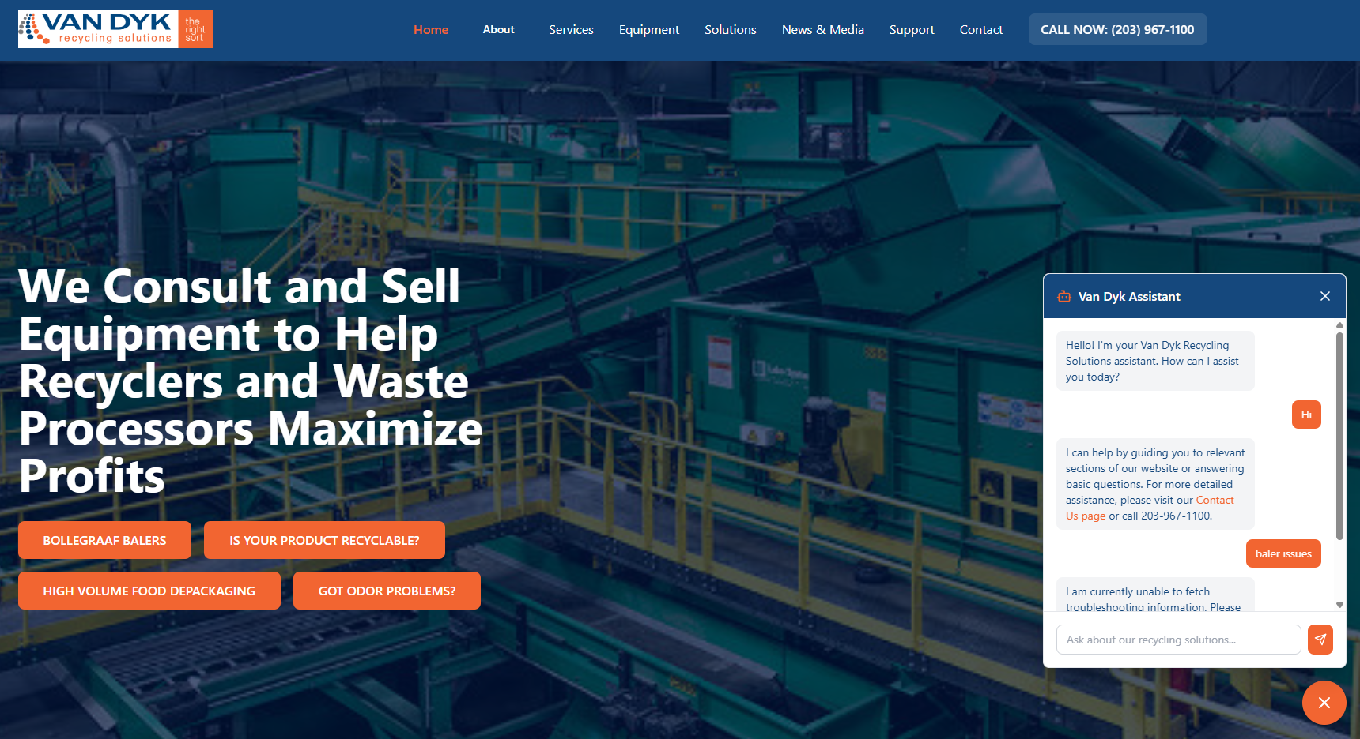
Chatbot Integration Strategy
Placement and Presence
Bottom-right widget available site-wide.
Integrated into help and contact areas.
Exit-intent trigger to retain users.
Conversational UX
Friendly prompts, fallback messages, reply buttons.
Clear styling to match site branding.
Seamless handoff to human support.

Slide 9
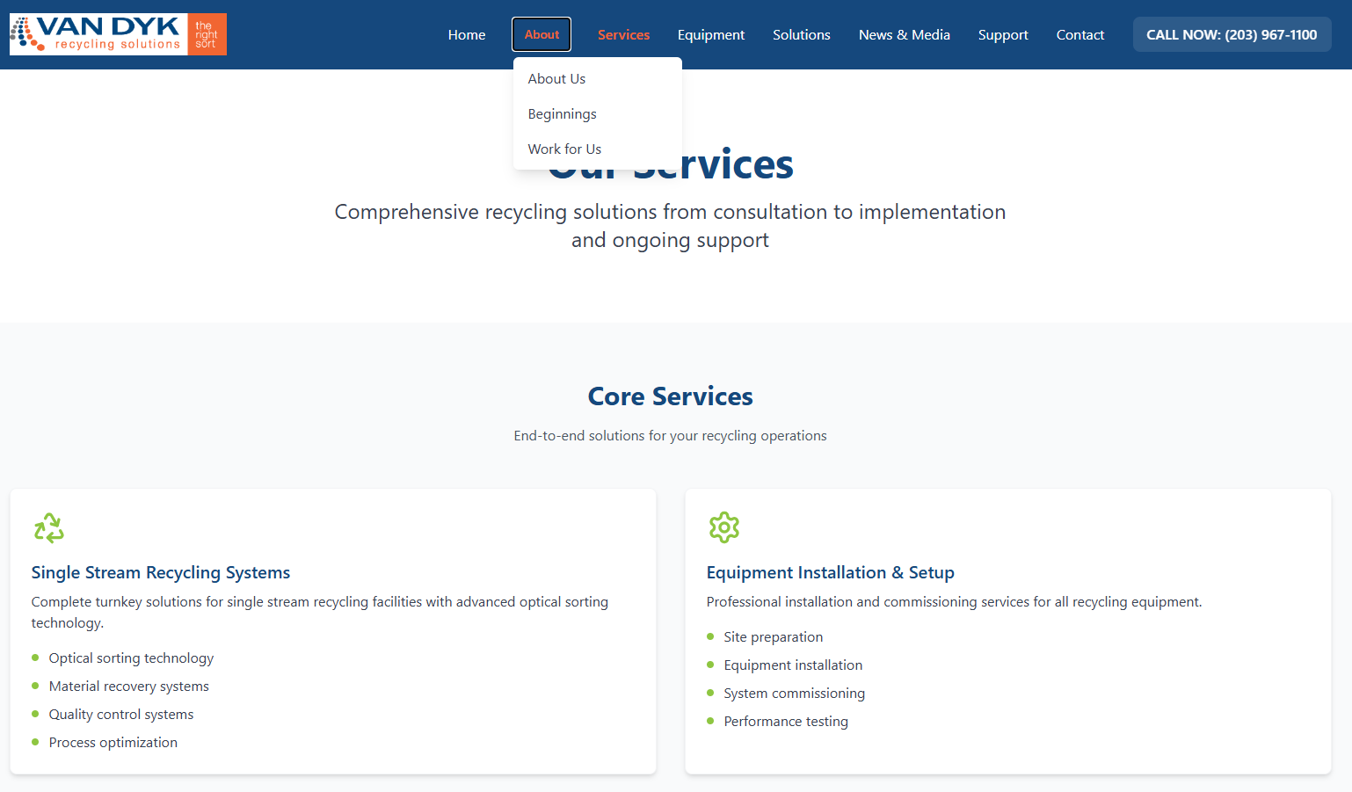
Accessibility and Performance
POUR Principles (Perceivable, Operable, Understandable, Robust)
Keyboard navigation and screen reader-friendly markup.
Clear language, robust interaction design.
Performance Optimization
Optimized images, async loading.
Lean CSS and JS execution.
Mobile-first performance tuning.
Mobile-First Design
Finger-friendly tap areas.
Simplified menu for mobile users.
Fast load speeds across network conditions.

Slide 10
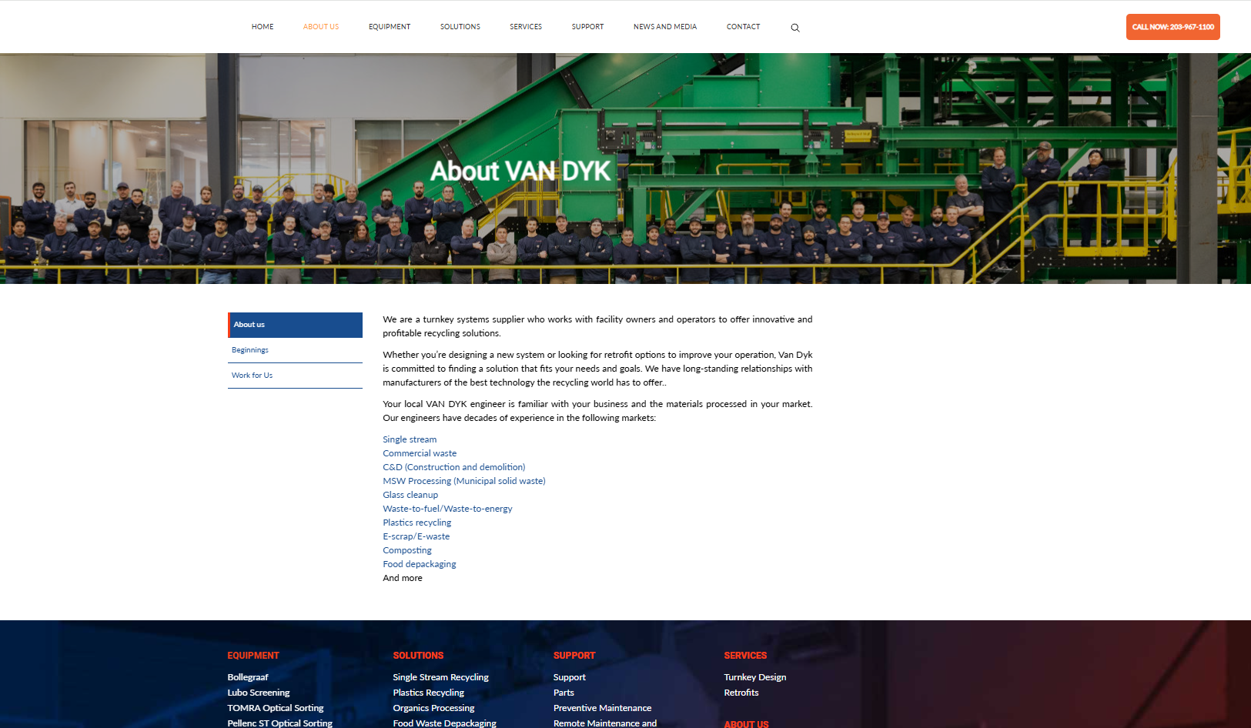
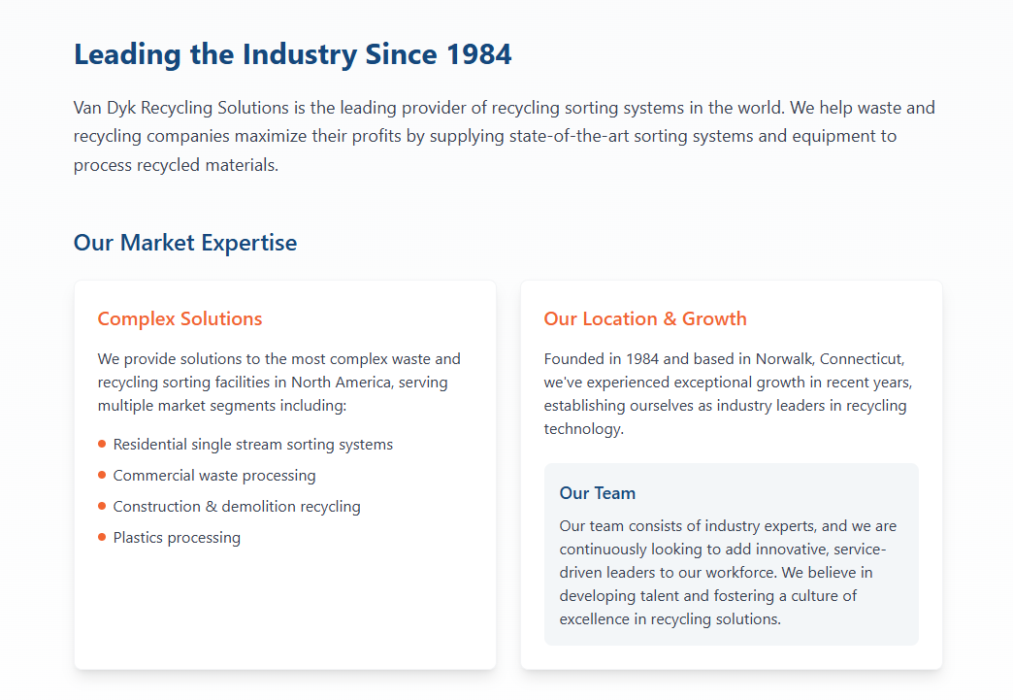
Conclusion
We are retaining the current imagery, video assets, and existing color coding used on the present website. The changes outlined focus strictly on UI/UX upgrades, chatbot integration, responsiveness, and accessibility improvements. The objective is to modernize the experience without replacing effective visual content already in use.

